Slide 1
Behavior Implementation Plan Student Name Institutional Affiliation Course Name and Number Instructor's Name Assignment Due Date

Slide 2
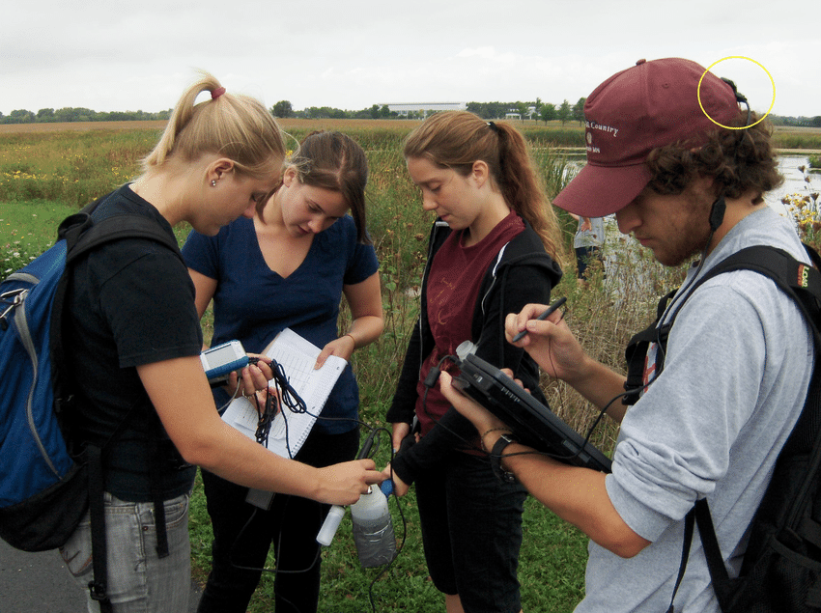
Data Collection Graphics
The image alongside shows students carrying out data collection in the field. They use the data to make the implementation of behavioral change plan.

Slide 3

Students Analyzing Data
The image alongside shows students carrying out data analysis.

Slide 4

Students Studying
The alongside image shows students studying in implementation of the set behavioral change plan.

Slide 5

Evaluating Results
The figure alongside shows a student evaluating results upon performing well in an examination.

Slide 6

Celebrating Results
The figure alongside shows students celebrating results after successful examination.

